Slide 1

Improvement and Reflection Time
Once you have your book, check for my comments.
If I have written any questions, or points for development on your work, please use this time to address these.

Slide 2



What can you infer about the character of Prim from your quotation?
How do you start analysing a quotation?
Underline the key words in your quotation.
Answer your key questions, trying to give more than one interpretation and going into lots of detail when inferring and analysing.
What questions can you ask about the key words you have underlined?
Notes:
Groups to join with other groups that analysed the same quote.

Slide 3
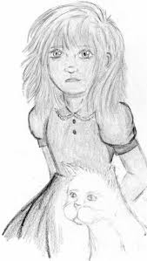
Prim
Stick your copy of the ‘Prim’ quotation sheet in your book.
As each group feeds back to the class, make sure you are making analysis notes on your own copy of the sheet.
Learning Objective: To make inferences about a text.
Notes:
Then finish reading Chapter 1.

Slide 4
Learning Objective: To make inferences about a text.
What language technique has been used here?
“Prim’s face is as fresh as a raindrop, as lovely as the primrose for which she was named.” (pg 3)
What does a raindrop symbolise? How can this be related to the character of Prim?
What does a primrose symbolise? What does this suggest about the character of Prim?
How might this quotation make the reader feel towards the character of Prim?

Slide 5
Learning Objective: To make inferences about a text.
Why has the word ‘guarding’ been used? What does this suggest about Prim?
Sitting at Prim’s knees, guarding her, is the world’s ugliest cat… Prim named him Buttercup insisting that his muddy yellow coat matched the bright flower.” (pg 4)
What does a Buttercup symbolise? Why is this a strange name to give to the cat and what does it suggest about Prim that she chose it?
What do Prim’s actions here demonstrate about her personality?
What does the word ‘insisting’ suggest about her personality?
How might this quotation make the reader feel towards the character of Prim?

Slide 6
Learning Objective: To make inferences about a text.
What does light hair imply about Prim’s personality?
“My mother and Prim with their light hair and blue eyes always look out of place.” (pg 9)
What does the colour blue symbolise? What could this imply about Prim’s personality?
Why has the writer specifically said that Prim always looks out of place? How might her character be different to the others around her?
How might this quotation make the reader feel towards the character of Prim?

Slide 7
Learning Objective: To make inferences about a text.
What does the word ‘first’ imply about Prim’s experience and feelings today?
“Prim is in my first reaping outfit, a skirt and ruffled blouse. It’s a bit big on her, but my mother has made it stay with pins.” (pg 17)
Why has the author dressed Prim in a skirt and blouse? How does this make her look to the audience? What does it imply about her personality?
Why has the author chosen to tell the reader that Prim’s mother has “made it stay with pins”? What does this imply about Prim?
Why has the author chosen to tell the reader that the clothes are a bit big for Prim? What is the effect of this?
How might this quotation make the reader feel towards the character of Prim?

Slide 8


Written response: How does Suzanna Collins present Prim chapter 1? Why does she present her this way? What is the effect on the reader when Prim gets chosen?
Challenge: In the last couple of paragraphs, how has the writer used repetition and sentences to build up tension?

Slide 9

Question
What do you think is the most concerning aspect of life in the 21st century?
e.g. climate change / government spying on citizens…

Slide 10
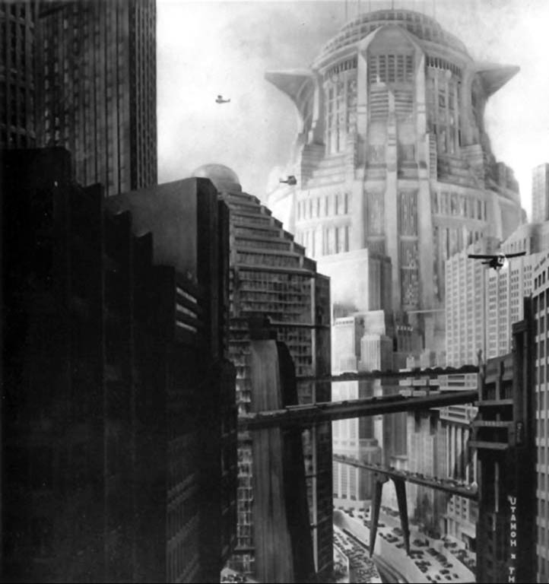
Learning Objective: To explore the conventions of dystopian fiction.
We are going to watch some trailers for dystopian films.
Whilst you are watching, make some notes on what you think the key conventions of dystopian fiction are.
Characters
Settings
Dystopian Fiction
Society
Technology

Slide 11
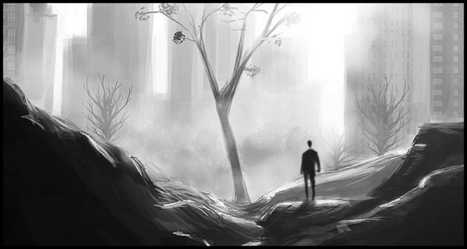
Learning Objective: To explore the conventions of dystopian fiction.
Now, read through the plot summaries of the dystopian novels in your groups.
Can you add any more to your notes about dystopian fiction?

Slide 12
What are the key conventions of Dystopian Fiction?
Your challenge is to use the information you have gathered to write a summary of the key conventions of the genre – in no more than 100 words.

Slide 13
Characteristics of a Dystopian Society
• Propaganda is used to control the citizens of society.
• Information, independent thought and freedom are restricted.
• A leader/concept is worshipped by the citizens of the society.
• Citizens are perceived to be under constant surveillance.
• Citizens have a fear of the outside world.
• Citizens live in a dehumanized state.
• The natural world is banished and distrusted.
• Citizens conform to uniform expectations. Individuality and dissent are bad.
• The society is an illusion of a perfect utopian world.
The Dystopian Protagonist
• often feels trapped and is struggling to escape.
• questions the existing social and political systems.
• believes or feels that something is terribly wrong with the society in which he or she lives.
How many of these key points did you manage to cover?

Slide 14
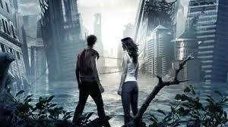
Your homework task
I would like you to write your own dystopian fiction.
You may choose to write the opening (first chapter?) of a longer novel, or write a short story.

Slide 15
Your homework task
You must use features of the dystopian fiction genre.
I would prefer work to be typed (size 12, readable font!).
Two sides of A4 (minimum).
Due – Tues 16th Sept.

